Slide 1

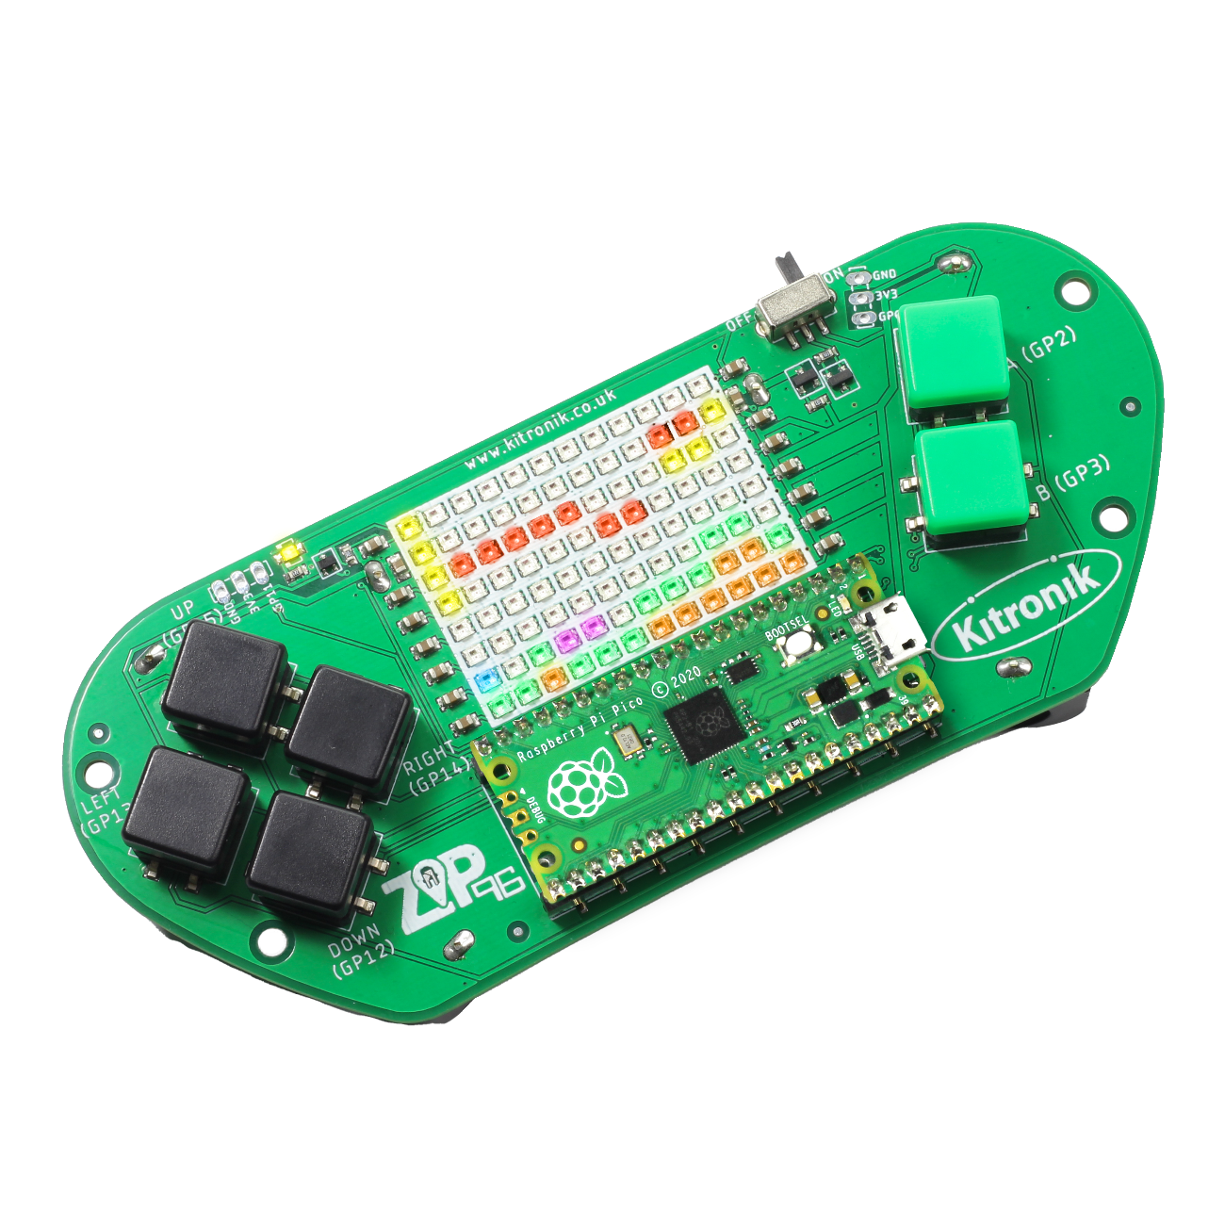
creating the a-mazing game
Computer Science

Slide 2

Aims & objectives
Computer Science
By the end of this lesson you will have:
Started writing the code for the A-Mazing Game.
Defined the ‘Player’ class
Tested player movement on the LED display screen.

Slide 3
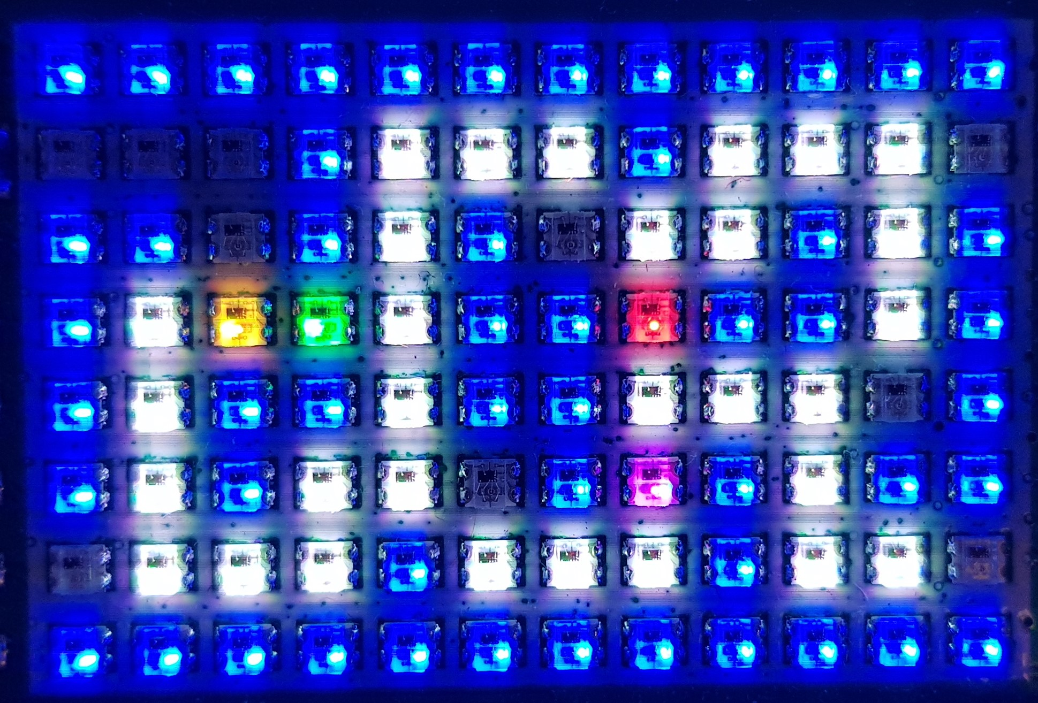
What is our a-mazing game?
Computer Science
A maze-based game where the player runs through a maze collecting gems – collect all the gems to win.
Three different enemies move around the maze as well, trying to stop the player from collecting gems.
One enemy moves randomly, one simply tries to move towards the player, the final one is smart and finds the best path through the maze to the player.
If an enemy catches the player, they lose a life. Once all three lives are lost… game over!

Slide 4
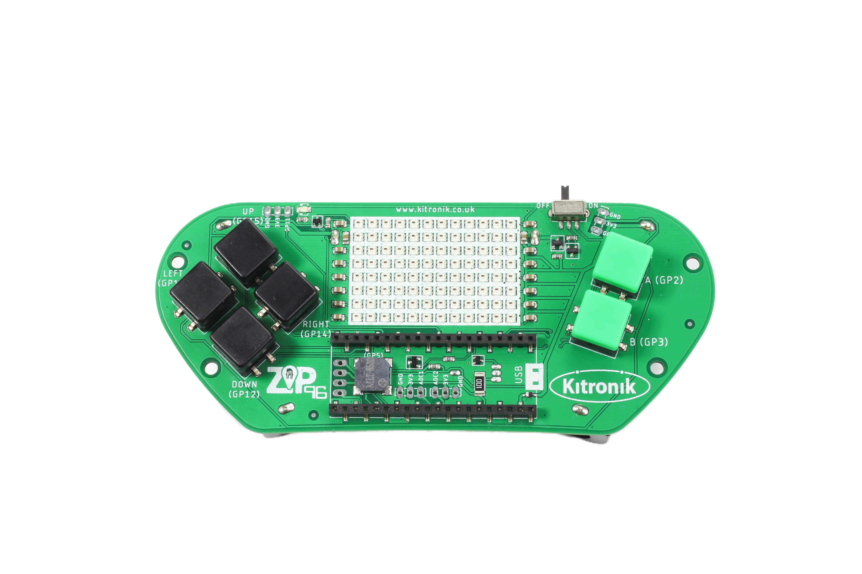
Thonny setup
Computer Science
Connect Pico ZIP96 to computer using a USB cable and open Thonny.

Slide 5
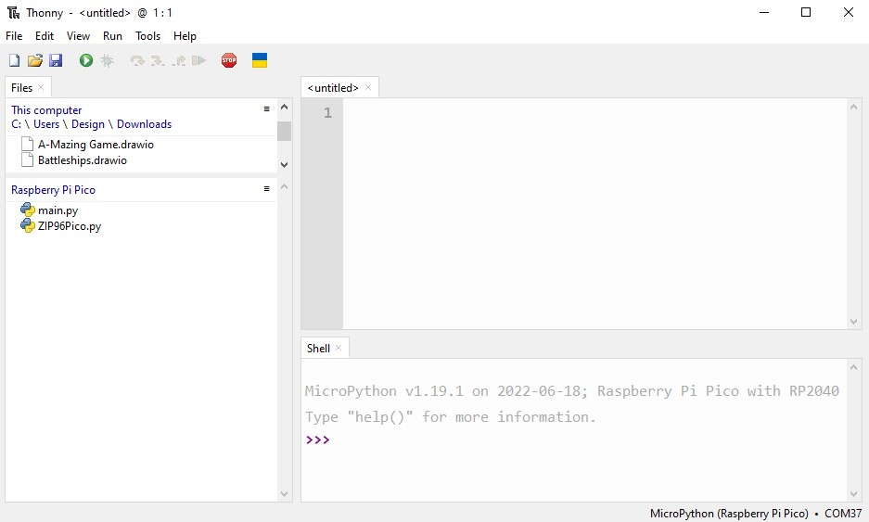
Thonny setup
Computer Science
Check the Pico device appears in the bottom right corner of Thonny.
Try pressing STOP if it does not appear automatically.
Turn on the ‘Shell’ by going to ‘View > Shell’.

Slide 6
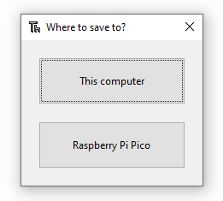
Thonny setup
Computer Science
Create a new file by clicking ‘File > New’.
Save it to the Pico by clicking ‘File > Save as’ and then select ‘Raspberry Pi Pico’.
Name the file ‘main.py’.

Slide 7
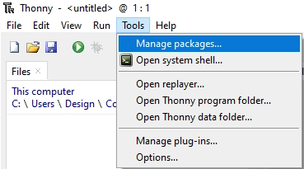
Thonny setup
Computer Science
Install the ‘ZIP96Pico’ library onto the Pico.
Click on ‘Tools > Manage Packages…’

Slide 8
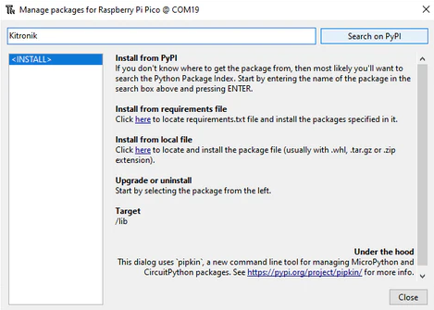
Thonny Setup
Computer Science
With the ‘Manage packages’ window open, search for ‘Kitronik’ and click the ‘Search on PyPI’ button.
Locate ‘KitronikPicoZIP96’ in the list of search results, then click the ‘Install’ button.
Confirm the install by clicking ‘Yes’ if prompted by Thonny.

Slide 9
Coding: libraries & variables
Computer Science
import ZIP96Pico
from utime import sleep
# Setup ZIP96Pico variables
screenWidth = 12
screenHeight = 8
gamer = ZIP96Pico.KitronikZIP96()
screen = gamer.Screen

Slide 10

Defining the player class
Computer Science
What information will the Player class need to store?

Slide 11
Defining the player class
Computer Science
What information will the Player class need to store?
The Player will need to know:
its x and y position on the screen,
the colour used for the player LED,
the screen object to draw the player on the ZIP96,
the screenWidth and screenHeight to detect when the player moves off the screen.

Slide 12
Coding: player class
Computer Science
Below the library imports, create the Player class:
# Class to store our player functionality
class Player():
# Player object constructor
def __init__(self, x, y, colour, screen, screenWidth, screenHeight):
self.x = x
self.y = y
self.colour = colour
self.screen = screen
self.screenWidth = screenWidth
self.screenHeight = screenHeight

Slide 13
Coding: player class
Computer Science
Inside the Player class, add a new function:
At the end of the Player __init__() function, call self.draw():
# Draw the current position on the screen
def draw(self):
self.screen.setLEDMatrix(self.x, self.y, self.colour)
self.screenHeight = screenHeight
# Draw the starting position
self.draw()

Slide 14
Coding: create player object
Computer Science
Below the variable definitions, create a Player object and show on the screen:
# Create an object for our player
player = Player(0, 1, gamer.Screen.YELLOW, screen, screenWidth, screenHeight)
# Show the created objects on the screen
screen.show()
Run the program to test the Player constructor

Slide 15
Coding: Add movement functionality
Computer Science
Which of the Player class parameters needs to be altered to add movement to the player?

Slide 16
Coding: Add movement functionality
Computer Science
Inside the Player class, add a new function below draw():
# Update the current position
def move(self, x, y):
# Change the current position by the x and y parameters
self.x += x
self.y += y
# Update the new position on the screen
self.draw()

Slide 17
Test player movement
Computer Science
Call player.move() with different values to check movement functionality:
# Example function calls
player.move(3, 4)
screen.show()
player.move(5, 7)
screen.show()
Run the program to test the Player move function

Slide 18
Test player movement
Computer Science
Are there any problems with how the move function currently works?

Slide 19
conclusion
Computer Science
In this lesson you have:
Imported libraries.
Setup the Pico ZIP96 as the ‘device’ variable.
Setup game variables of types integer, string.
Created the ‘Player’ class, it’s constructor and methods.

